Slide 1

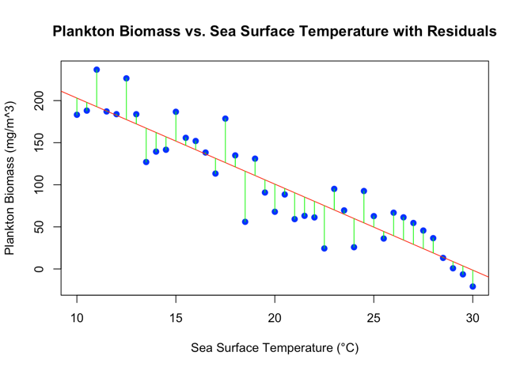
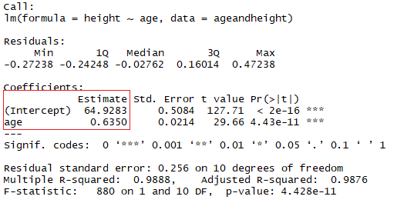
MES 503 - Research methods and tools I
Fall 2024
Lab 5 – Regression
18 Sept 2024
https://www.eurekalert.org/news-releases/474315

Slide 2
Today in lab:
Notice: assignment 1 grades are posted and emailed to you
Review assignment 2
This presentation
General reminders
Tips
Error bars
Naming conventions
Linear regression
Linear regression activity

Slide 3
Assignment 2
Did you clear your environment and run the whole script before submitting?
Why do we do this?

Slide 4

general reminders
Scripts that you submit to me must have commands to load libraries, not install them.
remove or comment out using # “install.packages()” from tops of your scripts.
keep library() commands
Common courtesy: don’t include anything in your code that changes the state of someone else’s computer.

Slide 5

general reminders
include annotated comments for each command to describe what it does.
I dont explicitly require this (YET) but it is helpful to you to describe what you are doing.
Remove “# Example Command” from beginning of commands

Slide 6
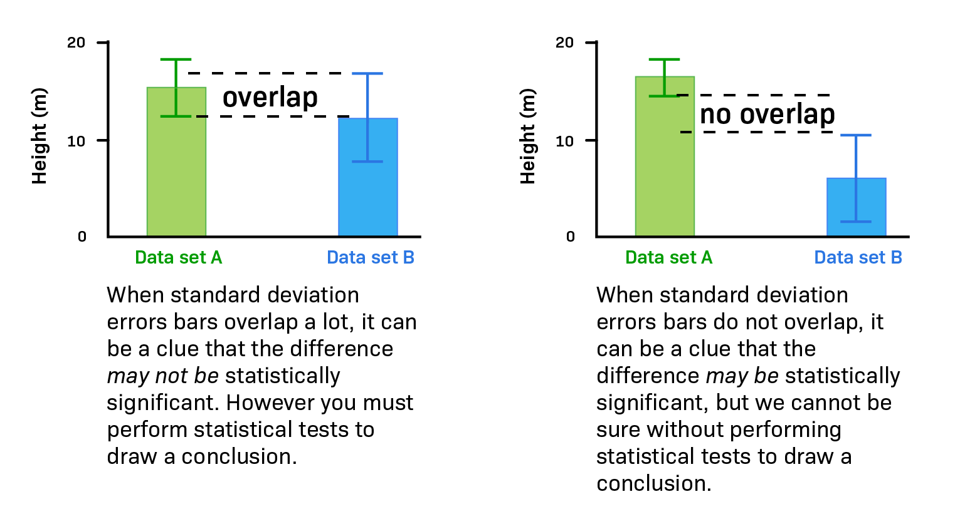
general reminders

Slide 7
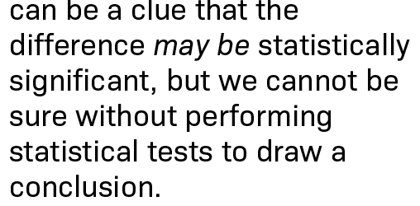
general reminders

Slide 8
general reminders

Slide 9
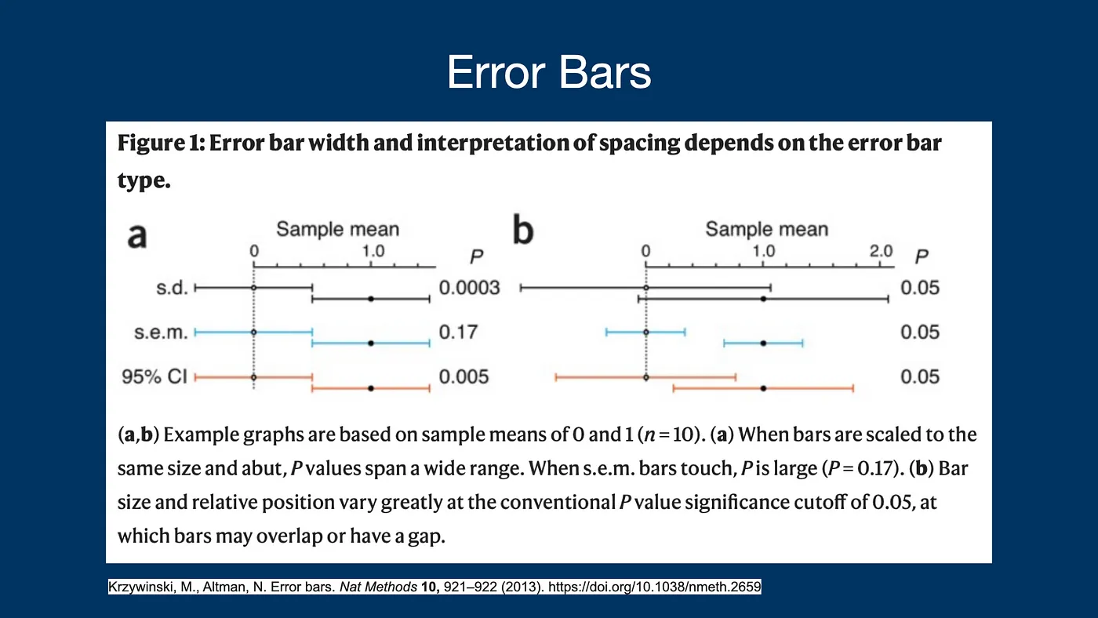

Slide 10
general reminders
This is why it is important to always specify which error bars you are using in your figure title or caption.
Same when you are reporting intervals in your text:
Eg. “…An average (± SEM) of 29.0 ± 1.75 species at Hind Bank East FSA…”

Slide 11
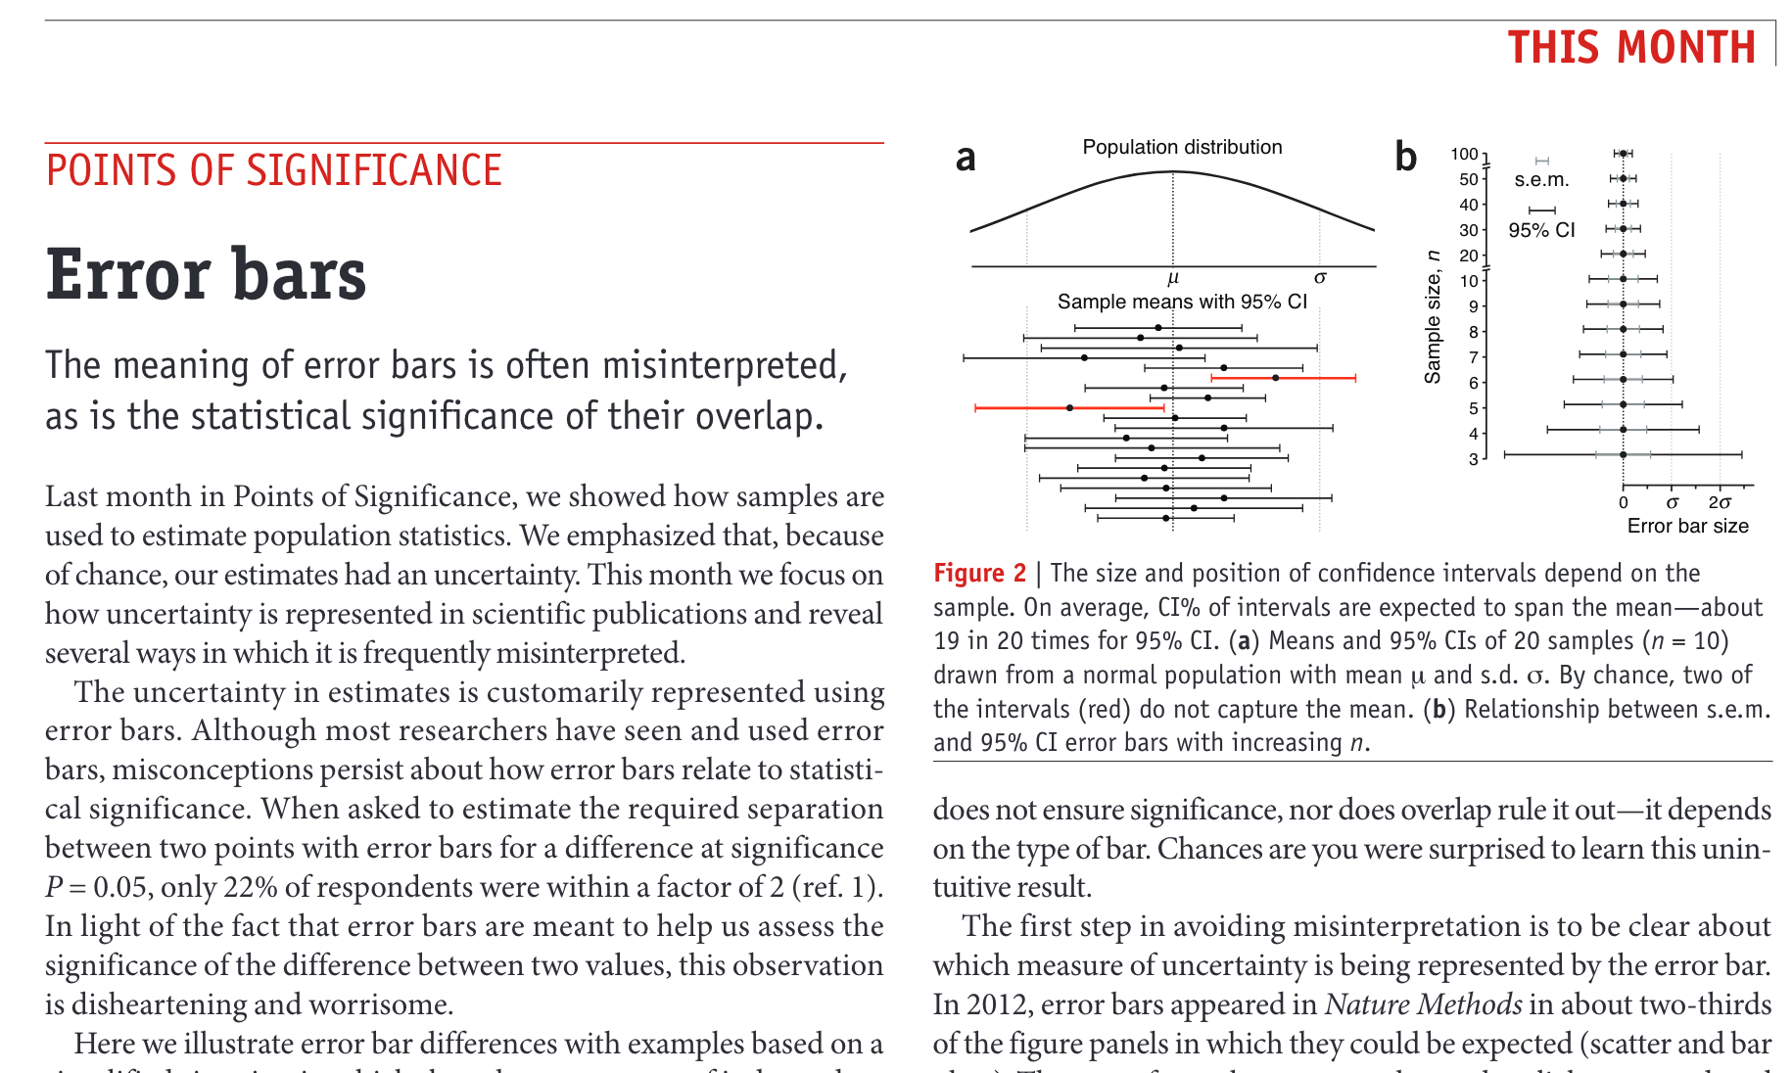
from Krzywinski, M., Altman, N. Error bars. Nat Methods 10, 921–922 (2013). https://doi.org/10.1038/nmeth.2659

Slide 12
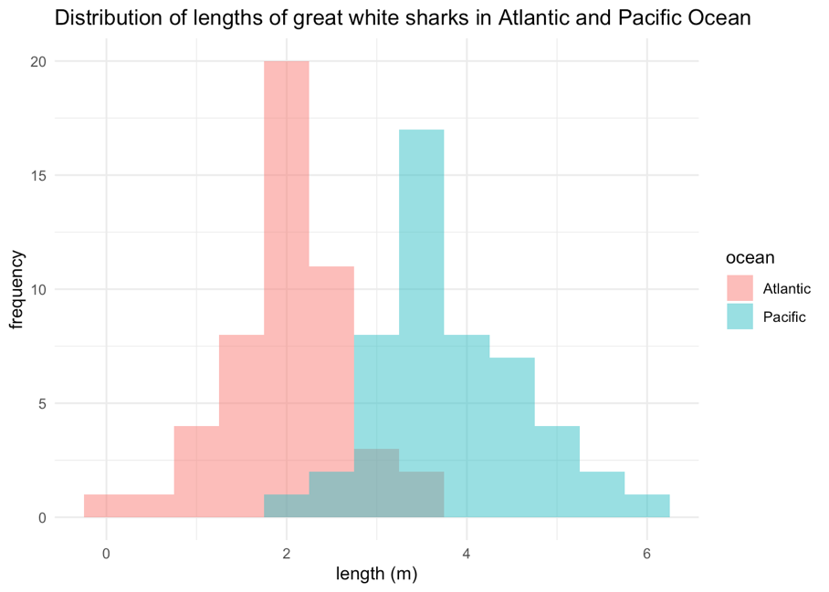
general reminders
The independent t-test assumes that the dependent variable* is approximately normally distributed within each group.
*Technically, it is the residuals that need to be normally distributed, but for an independent t-test, both will give you the same result.
Normal distributions are symmetric, which means they are “even” on both sides of the center (focus on shape, not skew)

Slide 13
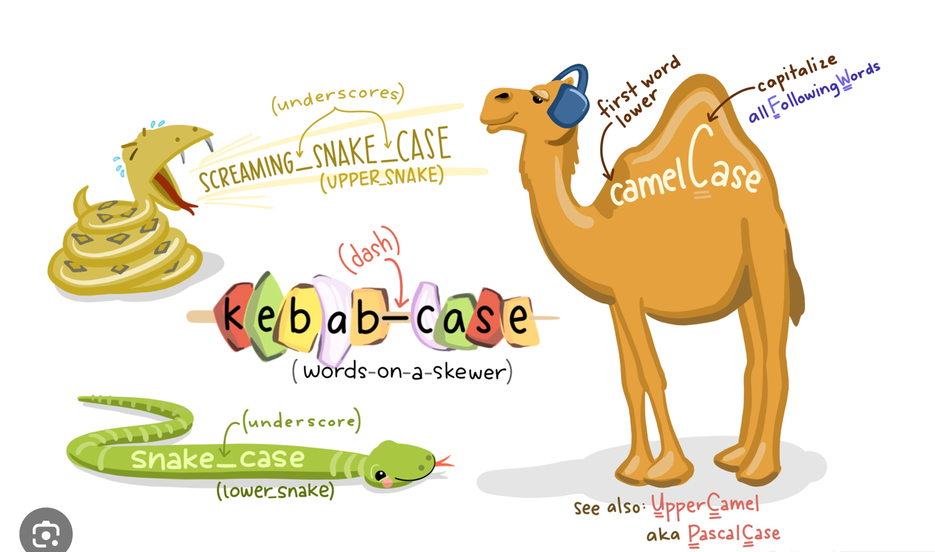
Naming Conventions
Typographical
@allison_horst
Notes:
Camel Case: First letter of first word is lowercase, and first letter of every following word is capitalized with no spaces or symbols between words.
Examples: iPad, eBay, fileName, userAccount.
Pascal Case: Popularized by Pascal programming language, this is a subset of Camel Case where the word starts with uppercase. Thus, UserAccount is in Pascal Case but not userAccount.
Snake Case: Words within phrases or compound words are separated with an underscore.
Examples: first_name, error_message, account_balance.
Kebab Case: Like Snake Case, but using hyphens instead.
Examples: first-name, main-section.
Screaming Case: This refers to names in uppercase.
Examples: TAXRATE, TAX_RATE.

Slide 14
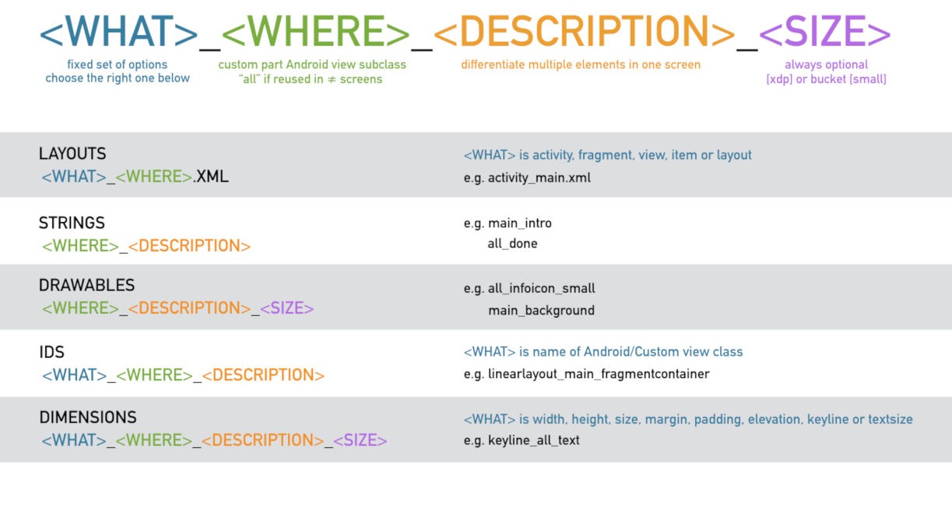
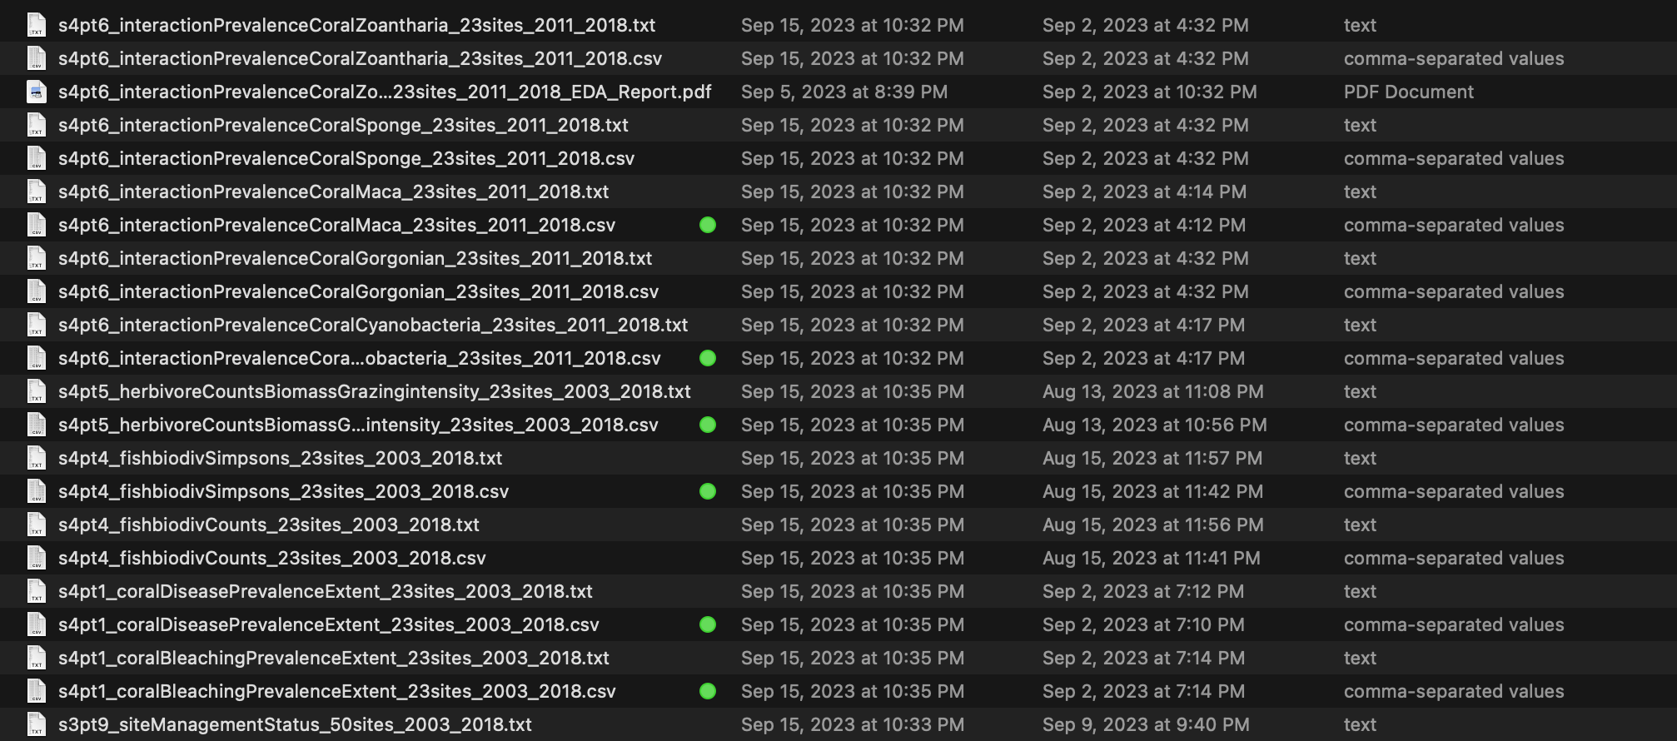
Naming Conventions
Files

Slide 15
Assignment 2
start assignment 2 review

Slide 16
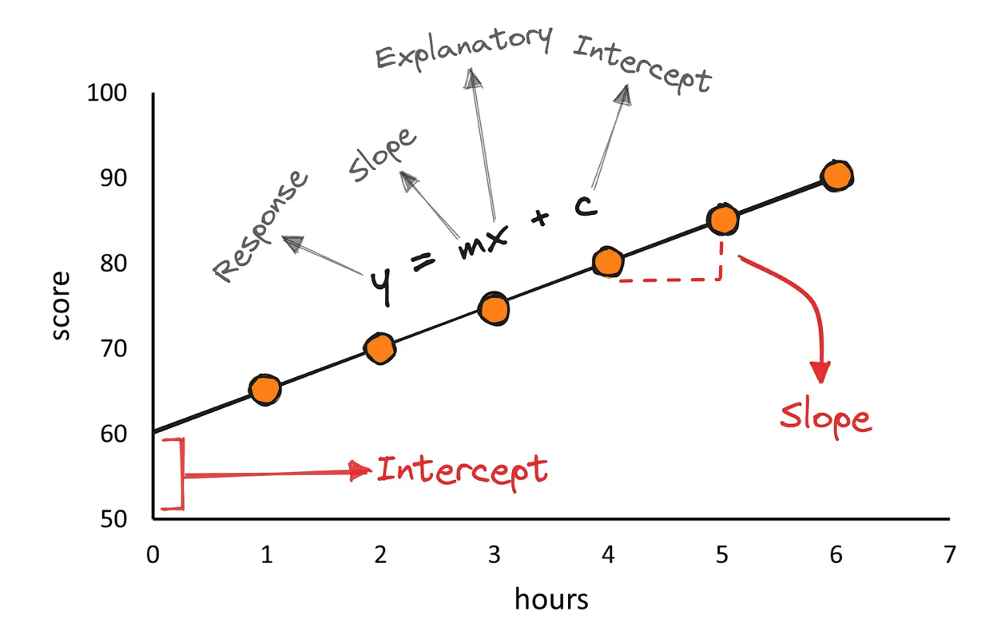
linear regression

Slide 17

https://towardsdatascience.com/linear-regression-explained-in-r-924ced3c2969

Slide 18
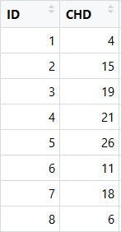
coronary heart disease mortality per 10k peoiple
country id
(arbitrary)
https://towardsdatascience.com/linear-regression-explained-in-r-924ced3c2969

Slide 19
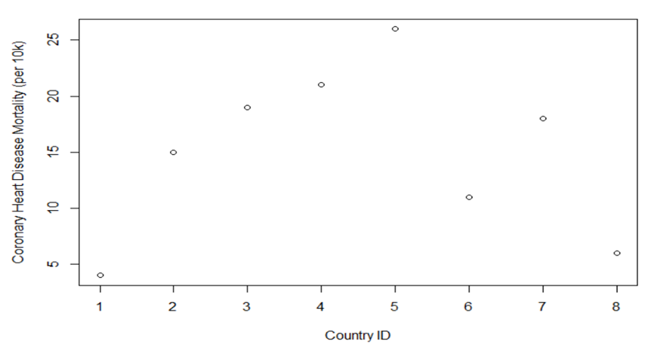
https://towardsdatascience.com/linear-regression-explained-in-r-924ced3c2969

Slide 20
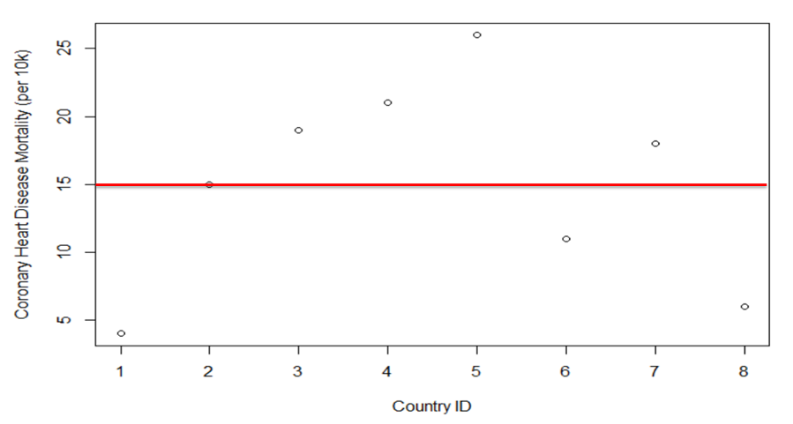
https://towardsdatascience.com/linear-regression-explained-in-r-924ced3c2969

Slide 21
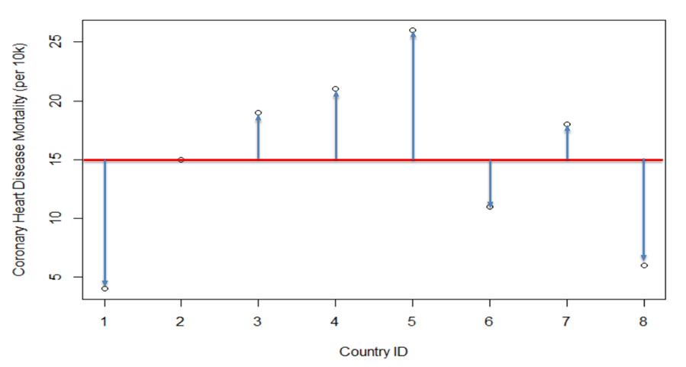
https://towardsdatascience.com/linear-regression-explained-in-r-924ced3c2969

Slide 22
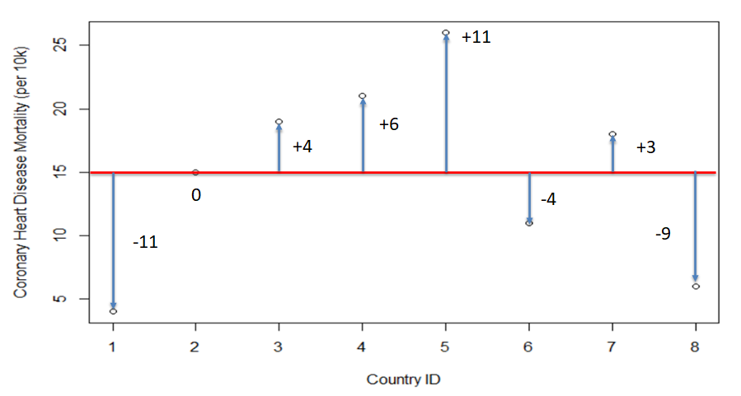
https://towardsdatascience.com/linear-regression-explained-in-r-924ced3c2969

Slide 23
positive residuals
https://towardsdatascience.com/linear-regression-explained-in-r-924ced3c2969

Slide 24
positive residuals
negative residuals
https://towardsdatascience.com/linear-regression-explained-in-r-924ced3c2969

Slide 25
positive residuals
line is a prediction of where points should be.
https://towardsdatascience.com/linear-regression-explained-in-r-924ced3c2969

Slide 26
residuals: observed y values - predicted y values
tell you how far the data falls from the line
line is a prediction of where points should be.
https://towardsdatascience.com/linear-regression-explained-in-r-924ced3c2969

Slide 27
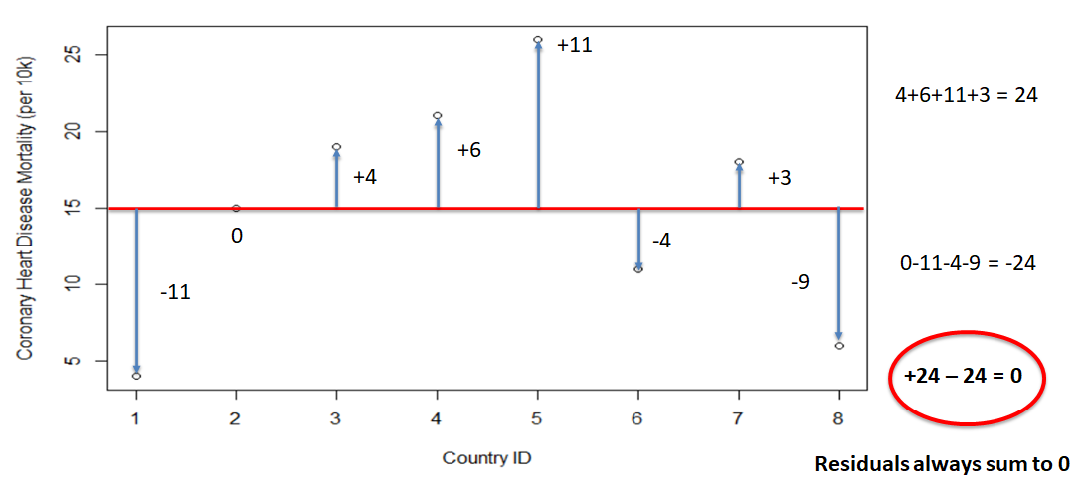
https://towardsdatascience.com/linear-regression-explained-in-r-924ced3c2969

Slide 28
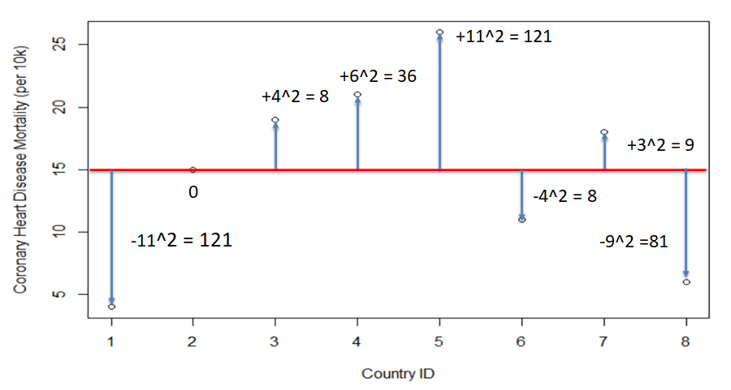
square the residuals – get absolute differences and emphasize large deviations
https://towardsdatascience.com/linear-regression-explained-in-r-924ced3c2969

Slide 29
square the residuals – get absolute differences and emphasize large deviations
https://towardsdatascience.com/linear-regression-explained-in-r-924ced3c2969

Slide 30
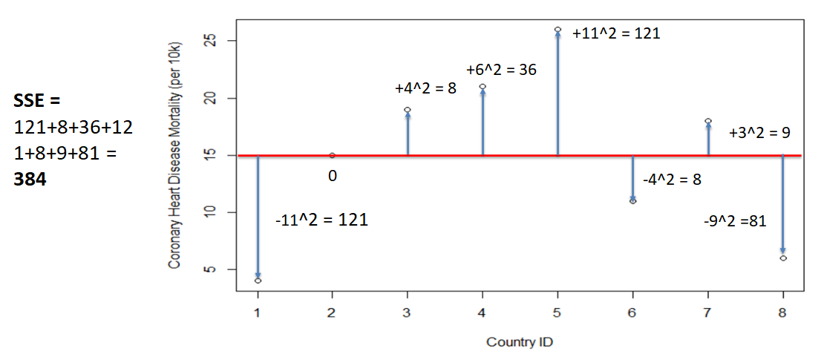
Sum of Squared Errors (SSE)
https://towardsdatascience.com/linear-regression-explained-in-r-924ced3c2969

Slide 31
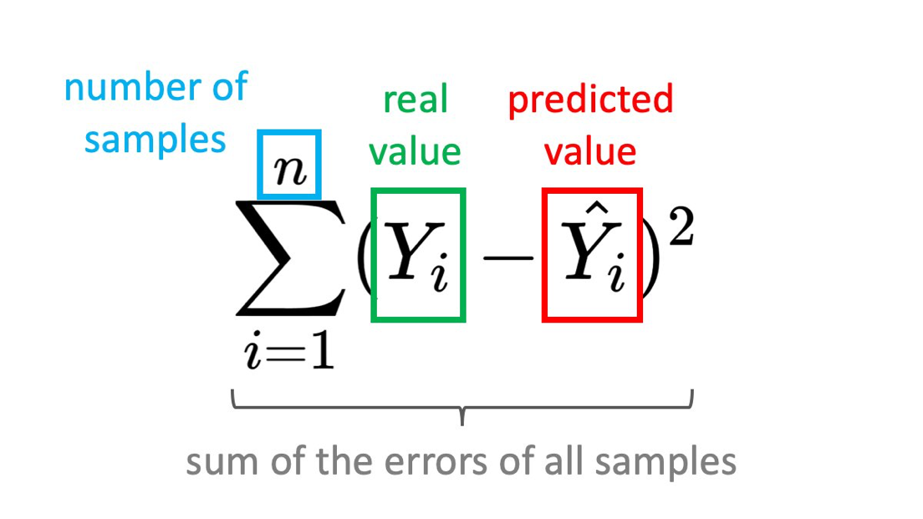
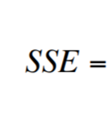
The goal of linear regression is to create a linear model that minimizes SSE.
https://towardsdatascience.com/linear-regression-explained-in-r-924ced3c2969
https://pub.towardsai.net/machine-learning-the-first-step-is-to-understand-simple-linear-regression-30dde8b4739

Slide 32
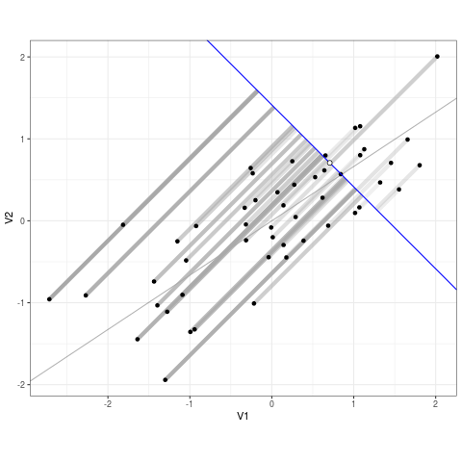
https://www.enchufa2.es/archives/least-squares-as-springs-the-shiny-app.html

Slide 33
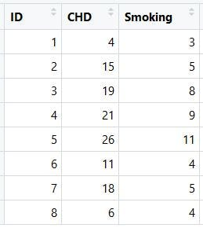
average cigarettes per adult per day
country id
(arbitrary)
coronary heart disease mortality per 10k peoiple
https://towardsdatascience.com/linear-regression-explained-in-r-924ced3c2969

Slide 34
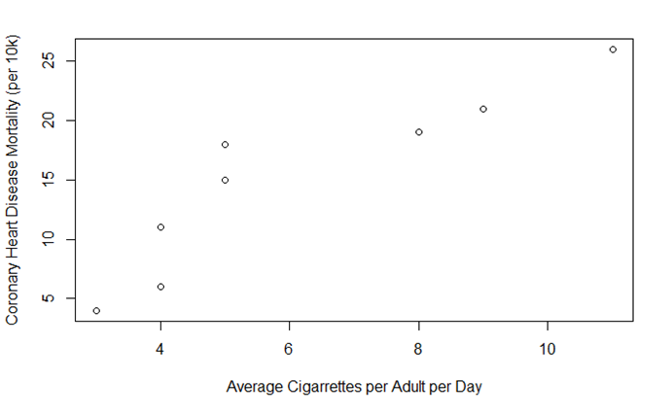
https://towardsdatascience.com/linear-regression-explained-in-r-924ced3c2969

Slide 35
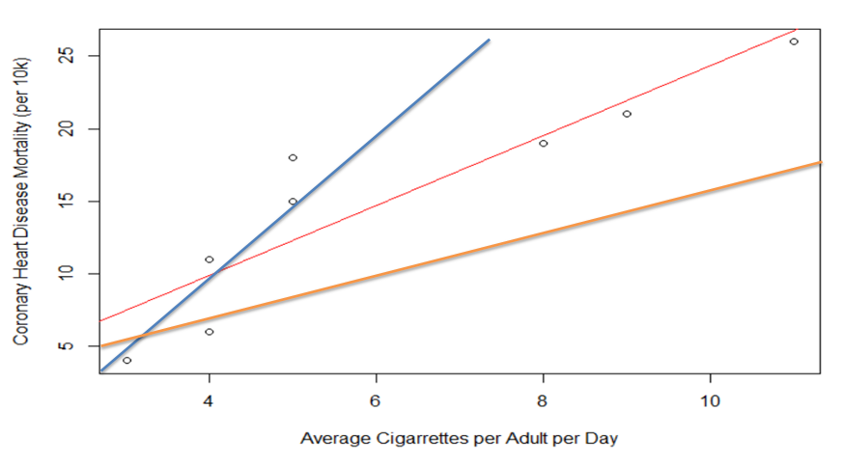
https://towardsdatascience.com/linear-regression-explained-in-r-924ced3c2969

Slide 36
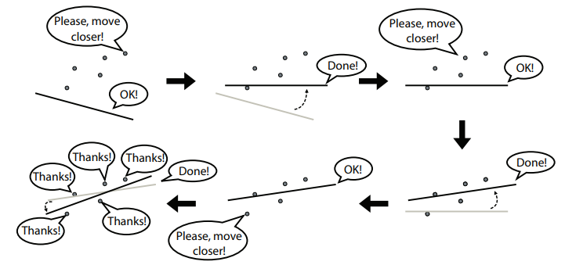
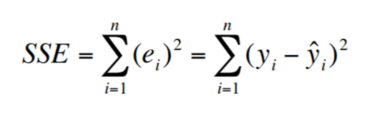
The goal of linear regression is to create a linear model that minimizes SSE.
https://towardsdatascience.com/linear-regression-explained-in-r-924ced3c2969
https://pub.towardsai.net/machine-learning-the-first-step-is-to-understand-simple-linear-regression-30dde8b4739

Slide 37
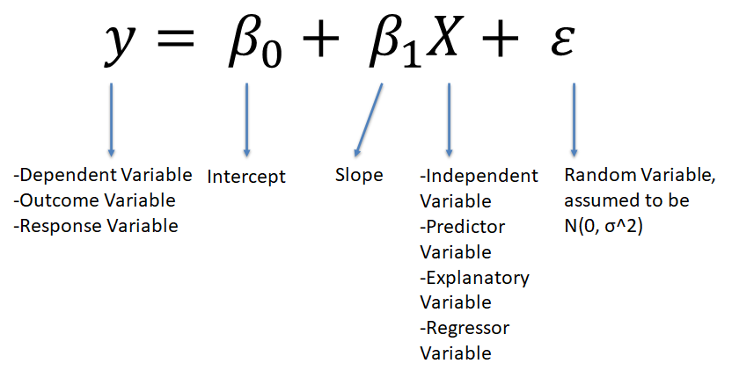
https://towardsdatascience.com/linear-regression-explained-in-r-924ced3c2969

Slide 38

https://towardsdatascience.com/linear-regression-explained-in-r-924ced3c2969
https://pub.towardsai.net/machine-learning-the-first-step-is-to-understand-simple-linear-regression-30dde8b4739

Slide 39
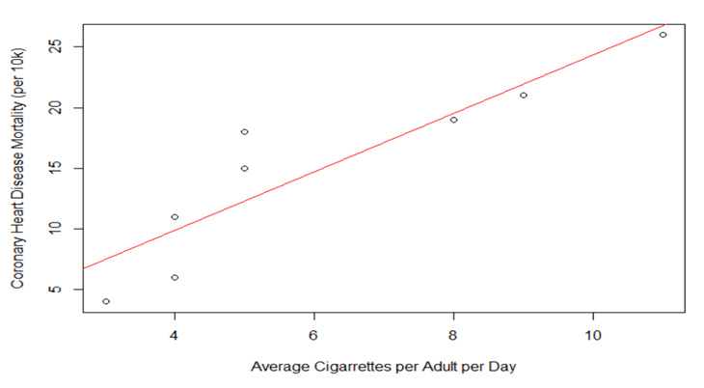
https://towardsdatascience.com/linear-regression-explained-in-r-924ced3c2969

Slide 40
https://towardsdatascience.com/linear-regression-explained-in-r-924ced3c2969

Slide 41
 | plot(df$Smoking, df$CHD, xlab='Average Cigarrettes per Adult per Day', ylab="Coronary Heart Disease Mortality (per 10k)")
 | abline(lm(data=df, CHD ~ Smoking ), col="red")
https://towardsdatascience.com/linear-regression-explained-in-r-924ced3c2969

Slide 42
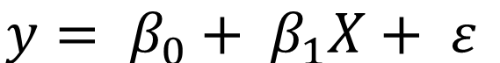
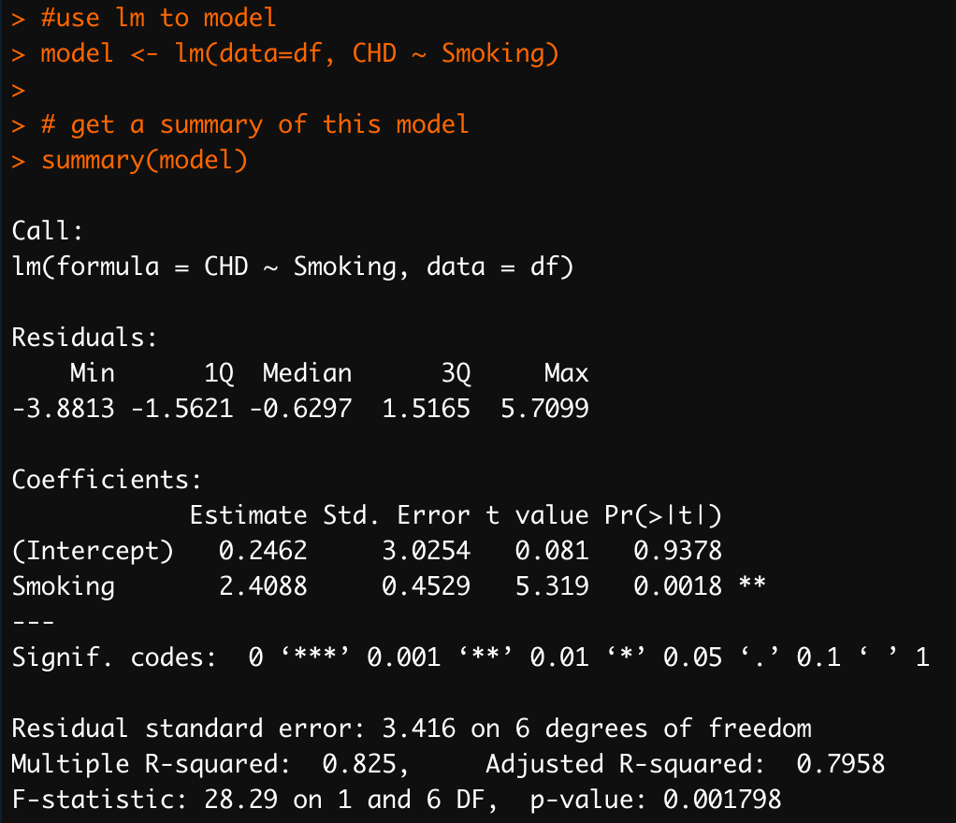
https://towardsdatascience.com/linear-regression-explained-in-r-924ced3c2969

Slide 43
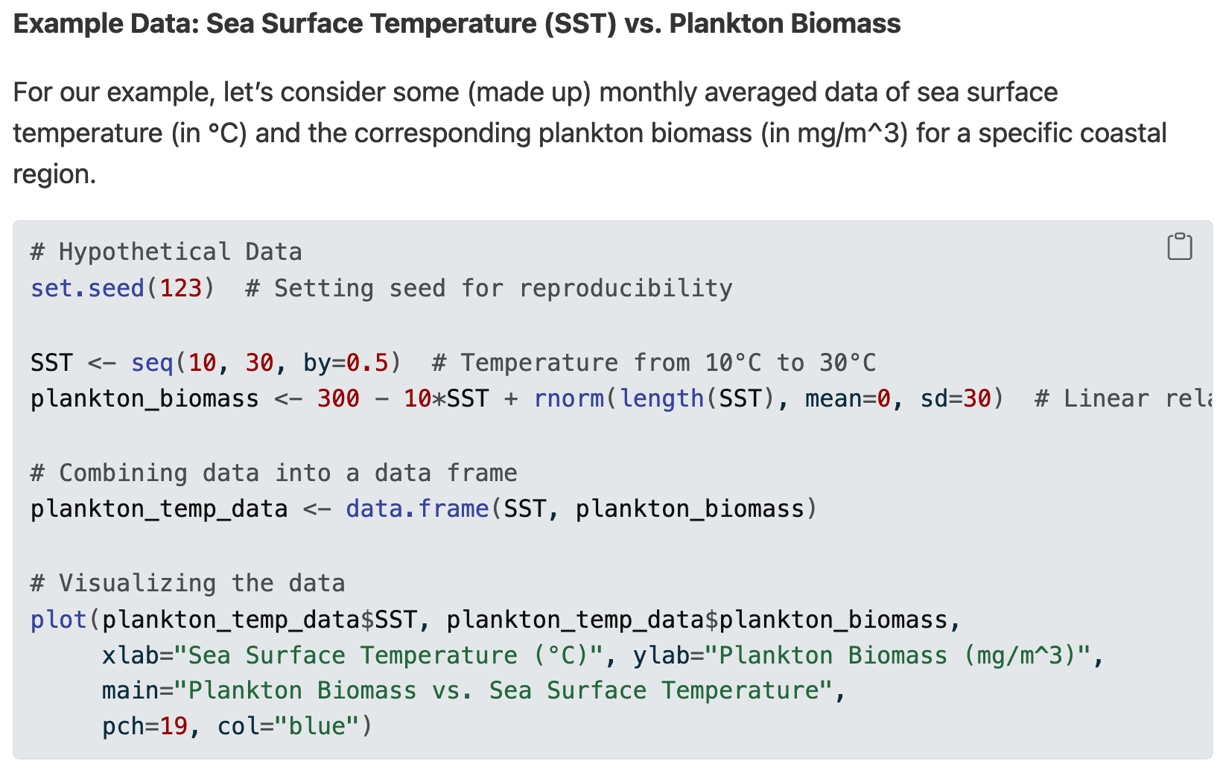
Simulated data – same as in your lab manual

Slide 44
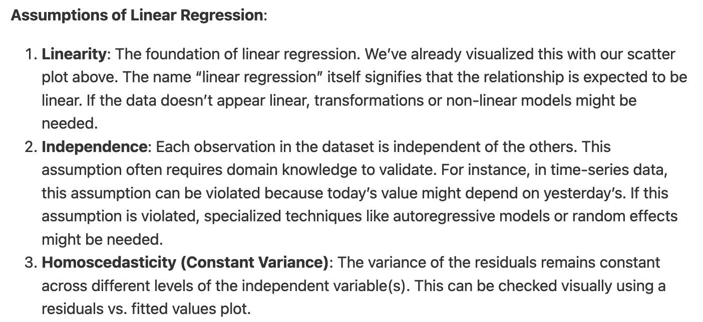
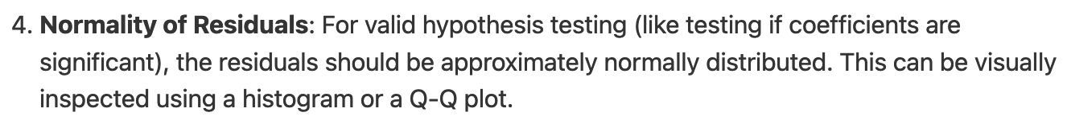
Linear regression assumptions – from your lab manual

Slide 45
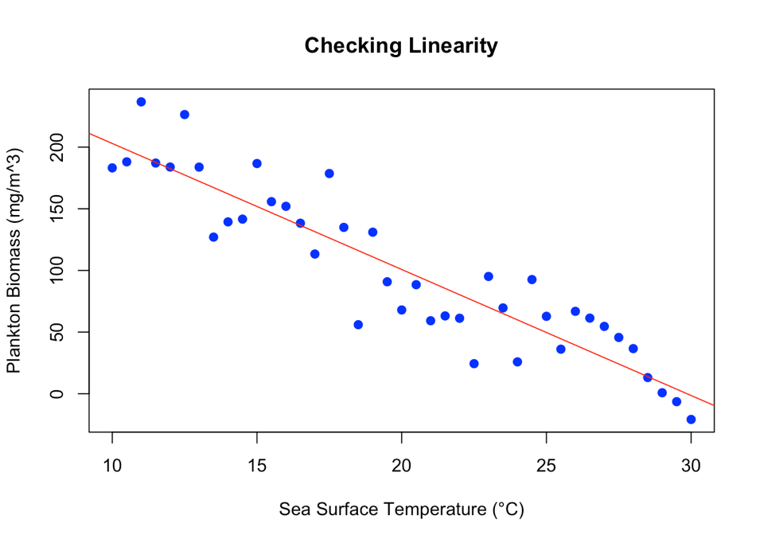
Assumption 1: LINEARITY
Foundation of linear regression
Relationship between variables should be linear
Visualized using scatter plot
If not linear, may need:
Data transformations
Non-linear models
Notes:
The scatter plot shows the relationship between Sea Surface Temperature and Plankton Biomass. The red line represents the linear regression fit. This visual check helps assess if the linearity assumption is met.

Slide 46
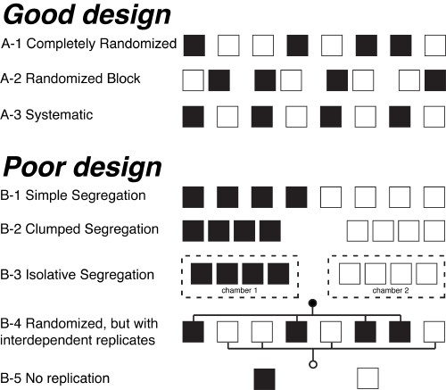
Assumption 2: INDEPENDENCE
Each observation must be independent of others
Requires domain knowledge to validate
Often violated in time-series data
If violated, may need:
Autoregressive models
Random effects models
Hurlbert 1984
Good designs (A-1 to A-3) ensure independence, while poor designs (B-1 to B-5) may violate the independence assumption.

Slide 47
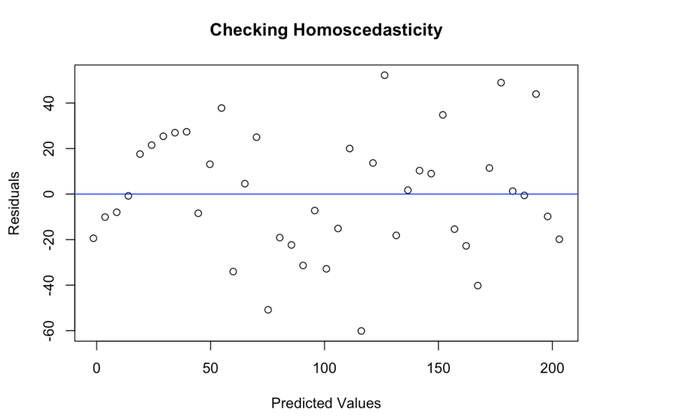
Assumption 3: HOMOSCEDASTICITY
Variance of residuals should be constant across all levels of independent variable(s)
Checked visually using residuals vs. fitted values plot
Look for constant spread of points around horizontal line
No clear patterns or funneling should be visible
The plot shows residuals vs. predicted values. A random scatter of points with consistent spread indicates that the homoscedasticity assumption is likely met.

Slide 48
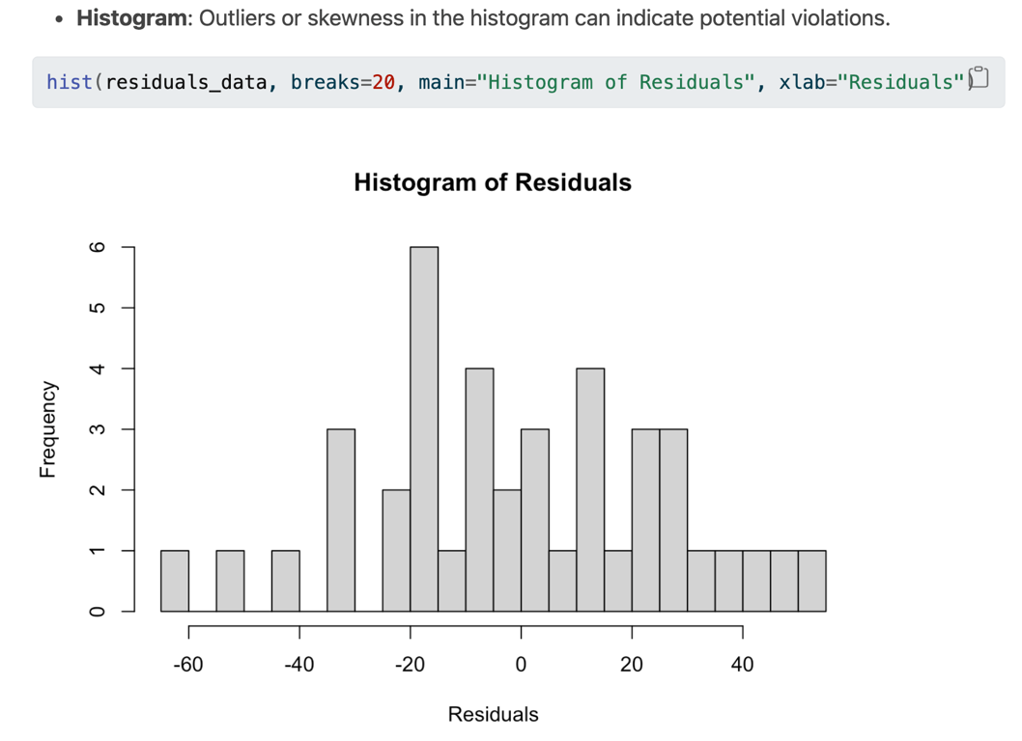
Assumption 4: NORMALITY OF RESIDUALS
Residuals should be approximately normally distributed
Can be inspected using histogram or QQ plot

Slide 49
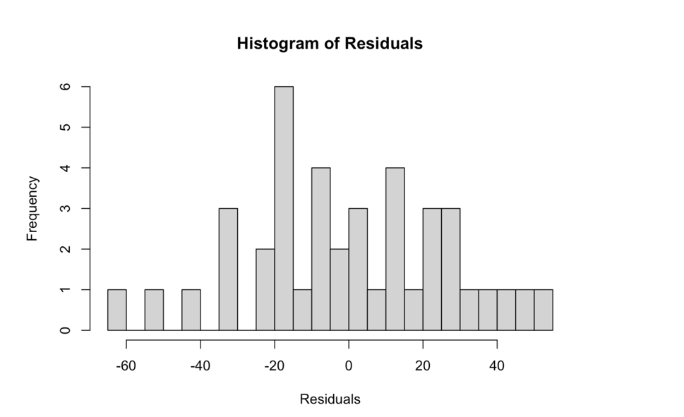
Assumption 4: NORMALITY OF RESIDUALS
Residuals should be approximately normally distributed
Can be inspected using histogram or QQ plot
Histogram of Residuals
Ideal: Bell-shaped, symmetric curve
Center should be around zero
Helps identify skewness or outliers
A symmetrical, bell-shaped histogram centered at zero suggests normally distributed residuals.

Slide 50
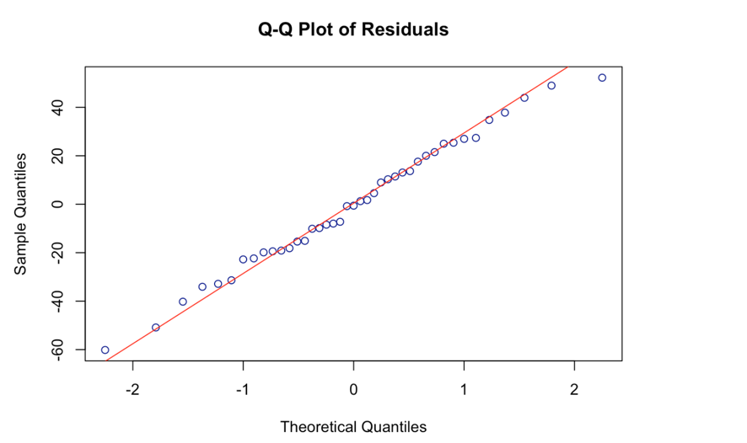
Assumption 4: NORMALITY OF RESIDUALS
Residuals should be approximately normally distributed
Can be inspected using histogram or QQ plot
Q-Q Plot of Residuals
Compares residuals to theoretical normal distribution
Ideal: Points follow a straight diagonal line
Deviations from line suggest non-normality
Sensitive to outliers, especially at ends

Slide 51
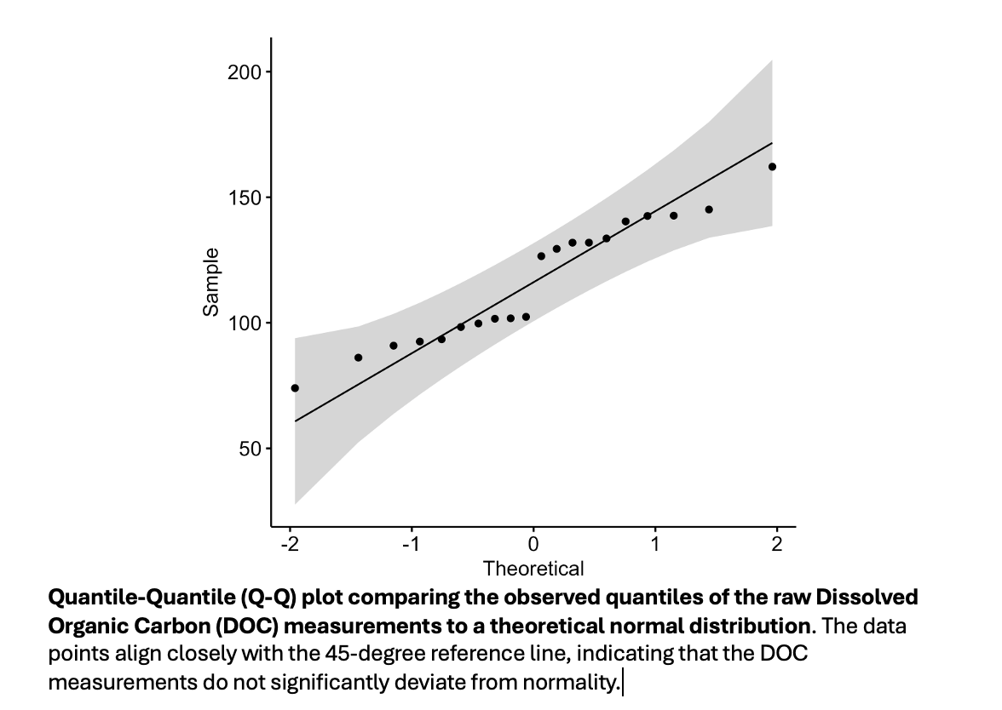

Slide 52
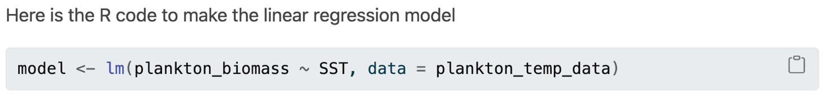
lm(): "Linear model" function
plankton_biomass ~ SST: Formula (response ~ predictor)
data = plankton_temp_data: Specifies data source
model: Resulting object with regression info

Slide 53
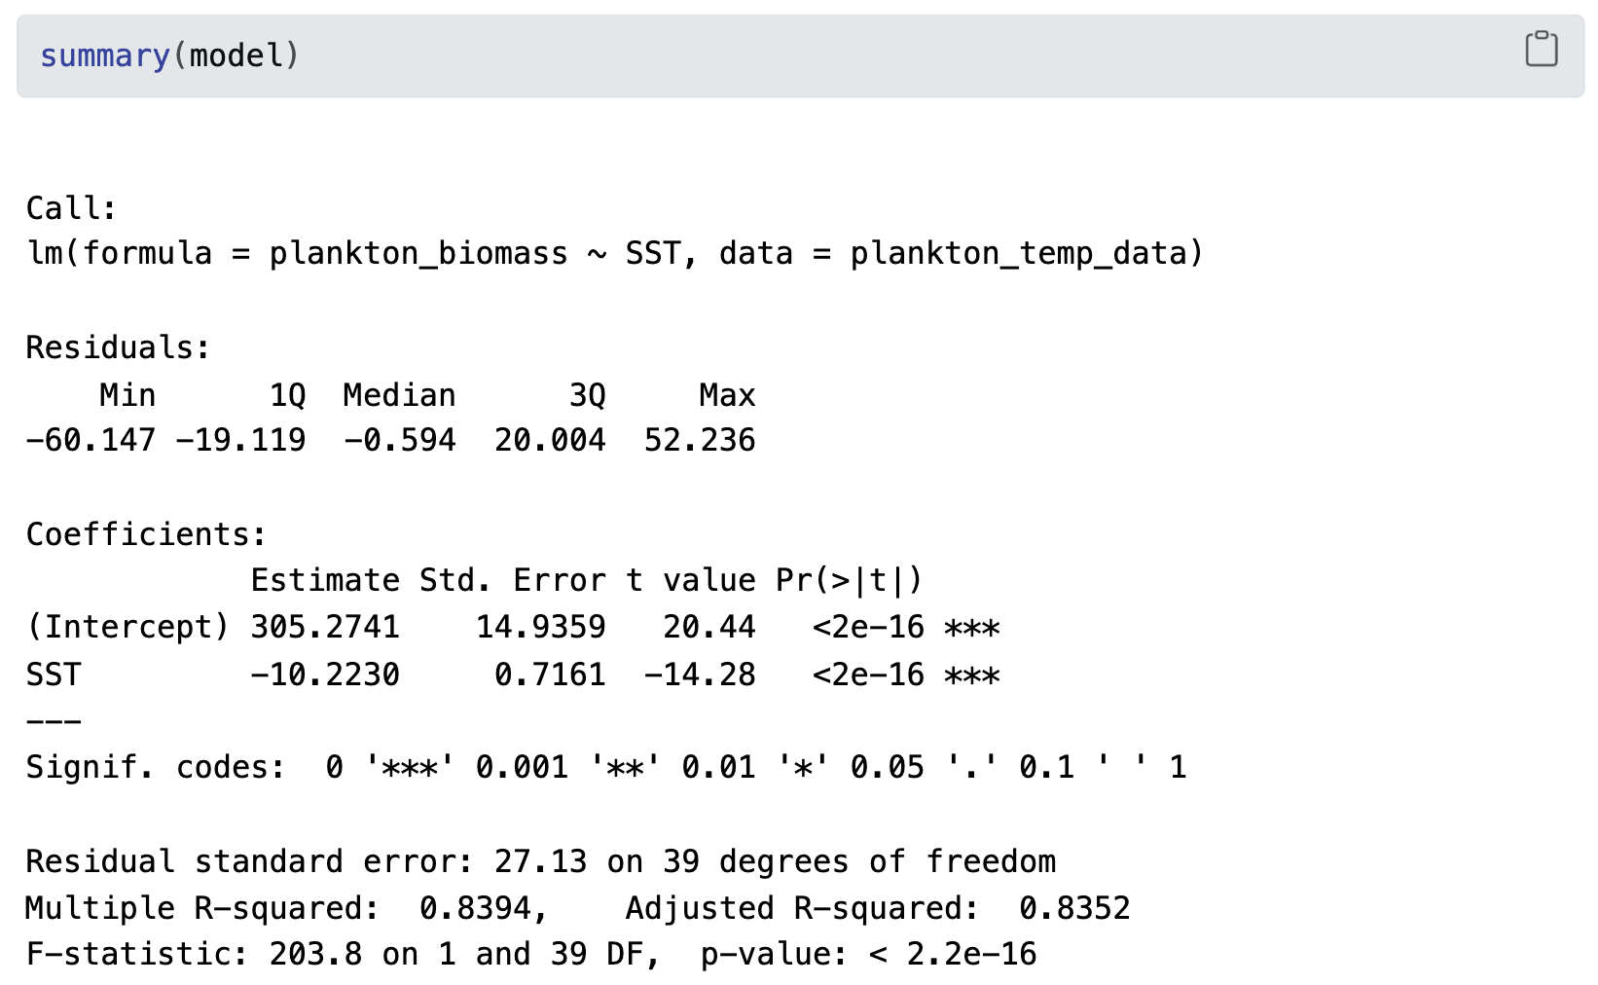
Call : “I’ve fit a linear model where I’m trying to predict or explain plankton_biomass using SST as a predictor, and the data for this analysis comes from the plankton_temp_data dataset.”

Slide 54
One H0 and H1 for Intercept

Slide 55
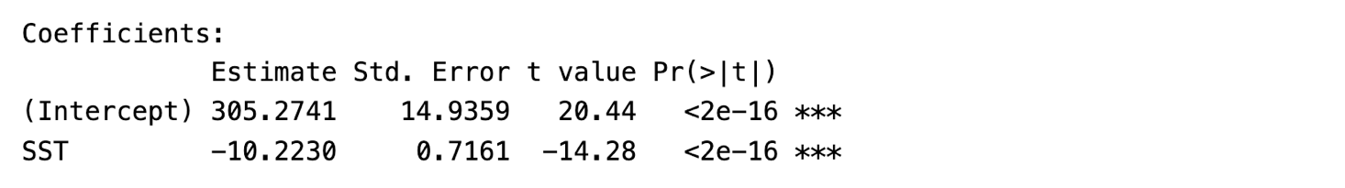
One H0 and H1 for Intercept
Intercept (β₀): Expected response when all predictors are zero
Null Hypothesis (H₀): β₀ = 0
Alternative Hypothesis (H₁): β₀ ≠ 0
Low p-value: Evidence that β₀ ≠ 0
High p-value: Not enough evidence that β₀ ≠ 0

Slide 56
One H0 and H1 for Intercept

Slide 57
One H0 and H1 for slope

Slide 58
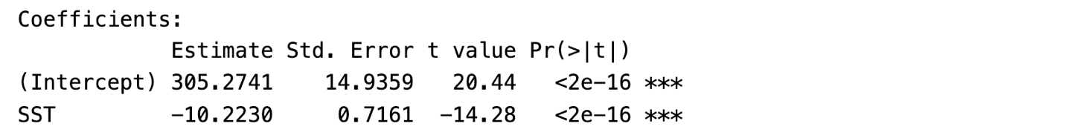
One H0 and H1 for slope
Slope (β₁): Expected change in response for one-unit change in predictor
Null Hypothesis (H₀): β₁ = 0 (no relationship)
Alternative Hypothesis (H₁): β₁ ≠ 0 (relationship exists)
Low p-value: Evidence of significant relationship
High p-value: Not enough evidence of significant relationship

Slide 60
Residual Standard Error (RSE)
Measures average distance of data points from regression line
Lower RSE = Better fit
Higher RSE = More unexplained variability
Degrees of Freedom (df)
Number of independent values that can vary in statistical calculation
Used to determine significance of predictors

Slide 62
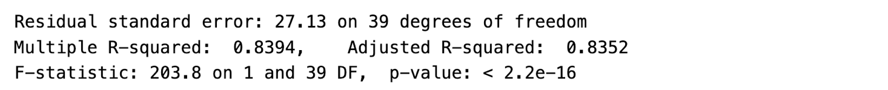
R-squared (R²)
Proportion of variance explained by the model
Higher value indicates better fit (0 to 1)
Example: R² = 0.8394 means 83.94% of variability explained
Adjusted R-squared
R² adjusted for number of predictors
Penalizes unnecessary predictors
Useful for comparing models with different predictors
Close to R² suggests relevant predictors

Slide 64
F-statistic = 203.8 on 1 and 39 DF
Tests overall significance of the model
Compares model to one with no predictors
Null hypothesis: All coefficients = 0
Alternative: At least one coefficient ≠ 0
Low p-value: Model is significantly better than null model
A high F-statistic with a low p-value suggests the model is statistically significant.

Slide 67
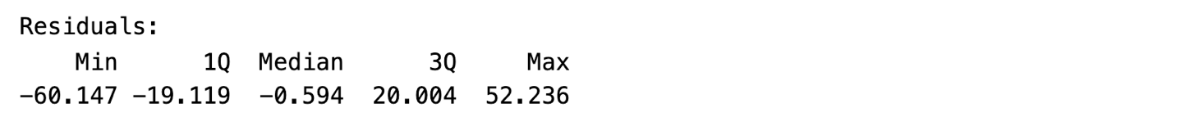
Summary of Residuals
Residuals: Differences between observed and predicted values
Symmetry around zero suggests good model fit
Range (min to max) indicates spread of errors
Large residuals may suggest outliers or poor fit in certain areas
Quartiles (1Q and 3Q) show distribution of errors
Quartiles close to zero indicate majority of predictions are accurate
Analyzing residuals helps assess model fit and identify potential issues.

Slide 68
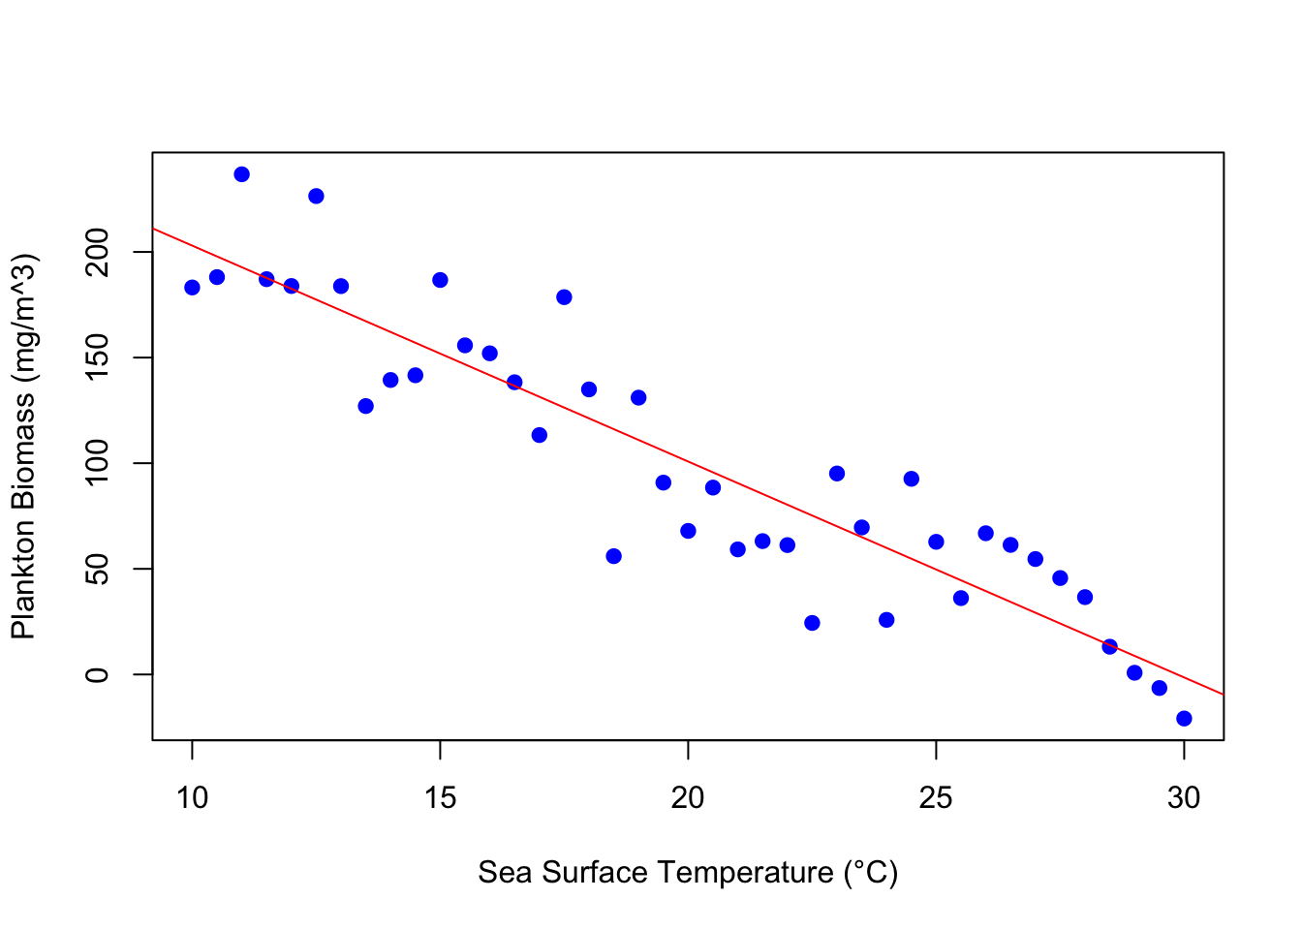
Is there a functional relationship between SST and plankton biomass?
What happens to plankton biomass as SST increases?

Slide 69
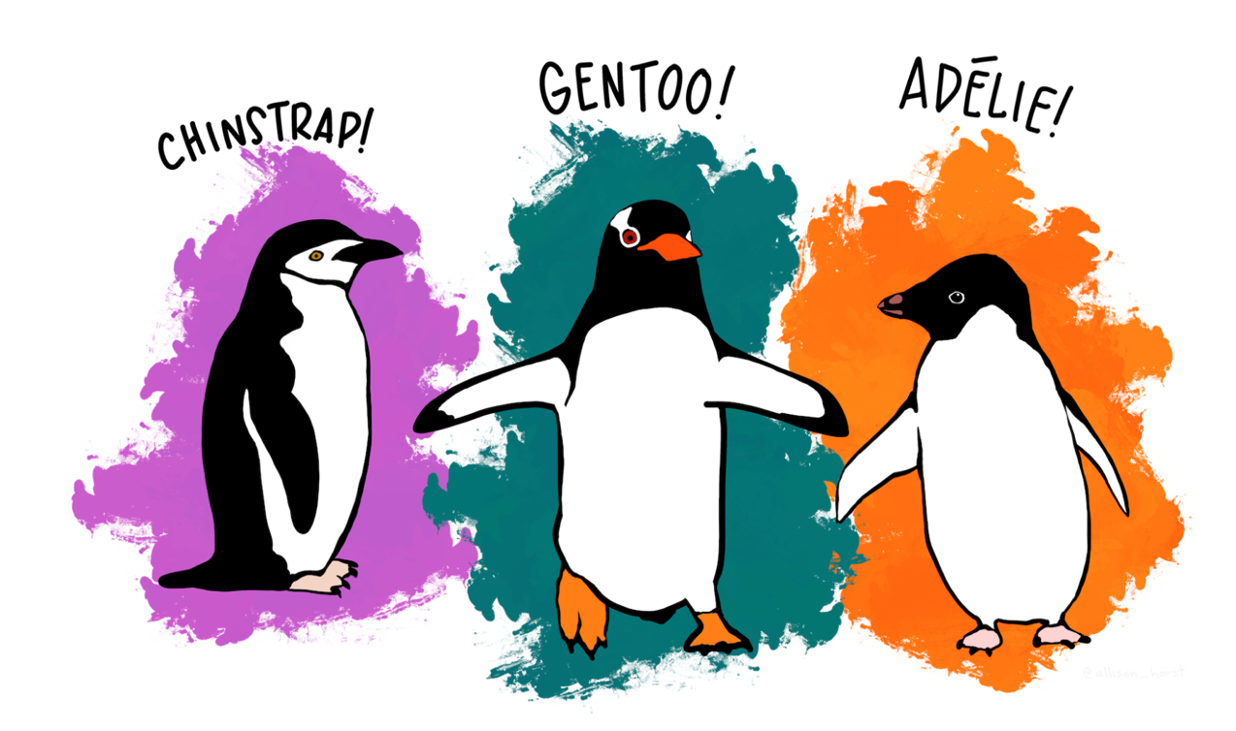
follow the tutorial, make your own R script to analyze the penguin data, and answer underlined parts

